Slide 1

Book Recommender systems
Group No : 2

Slide 2


Group Members:
Nayudu Srilakshmi
Akula Deepa
Tittu A
Mentors :
KARTHIK MUSKULA
Dhanyapriya Somasundaram

Slide 3

Business Objective
The objective of the analysis is to Generate the features from the dataset and use them to recommend the books accordingly to the users.

Slide 4
A recommendation System filters the data using different algorithms and recommends the most relevant items to users.
Applications:
The music and video companies like Netflix, Youtube and Spotify use them to generate music and video recommendations.
They are used by Amazon/Flipkart/online shopping websites for product recommendations.

Slide 5
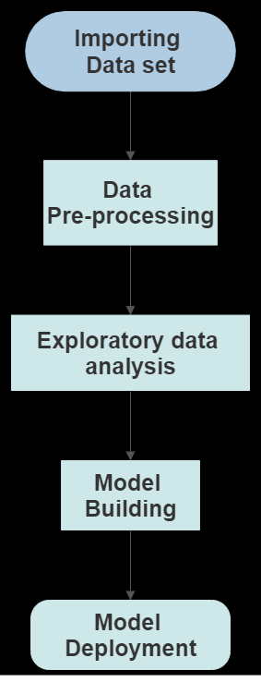
Project Flow Chart

Slide 6
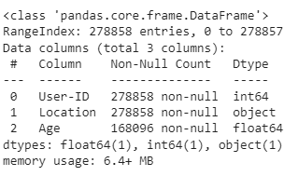
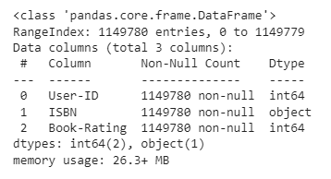
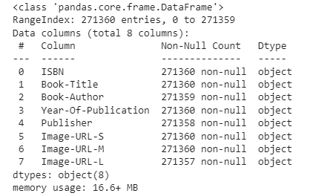
Data Set
User Dataset:
Consist of user ID , location, age Of user.
Consist of 2.7lakh data points
Shape of the data=(278858,3)
Duplicates=0
Rating Dataset:
Consist of user ID , ISBIN, Book rating .
Consist of 11.49lakh data points
Shape of the data=(1149780,3)
Duplicates=0
Book Dataset:
Consist of ISBIN, Book title, author ,year of publication, Cover image.
Consist of 2.7lakh data points
Shape of the data = (271360,8)
Duplicates=0

Slide 7
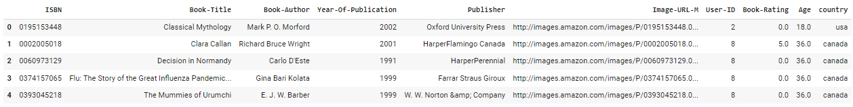
Final Dataset
Combined the 3 data set with selected feature
Shape of Combined dataset= (1017069,10)

Slide 8
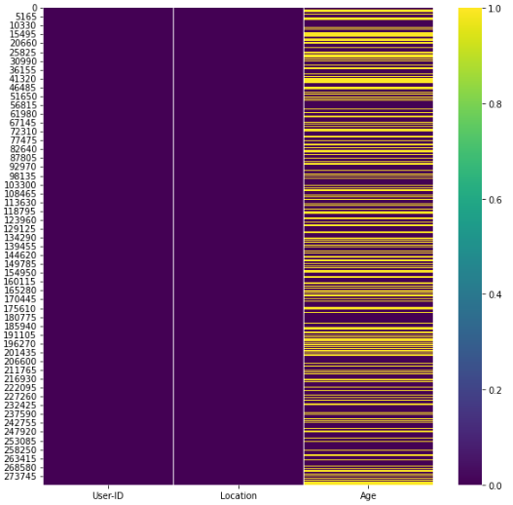
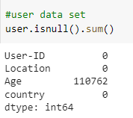
Missing Values
User Dataset
Almost 40 % of the data in Age column is missing.
Imputed the missing values with mode value.

Slide 9
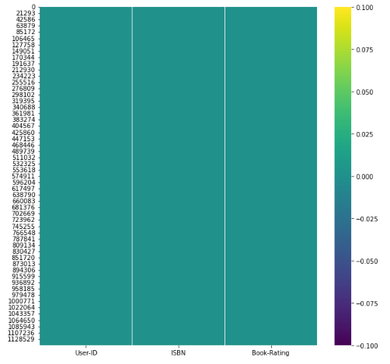
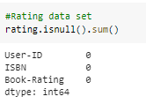
Missing Values
Rating Dataset
There are no missing values in the dataset

Slide 10
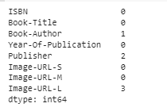
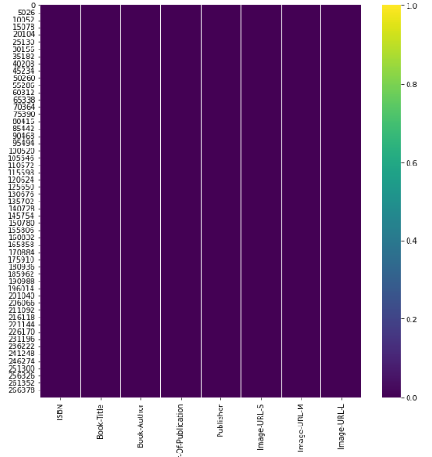
Missing Values
Book Dataset
Only few data points are missing
So we can drop these data points

Slide 11
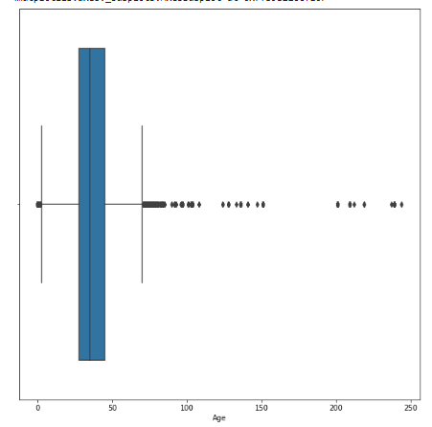
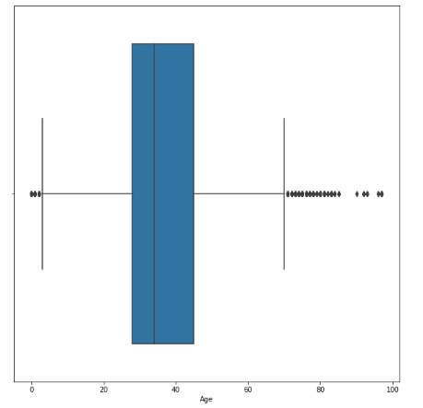
Outliers
Large amount of outlier were present in age column
Outlier of the age column we imputed with mode

Slide 12
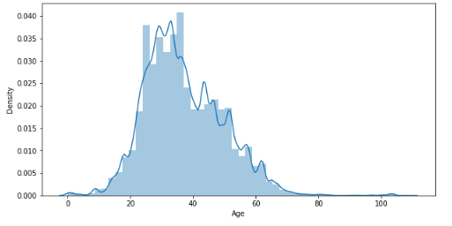
Exploratory Data Analysis
Distribution plot of Age, Here we can observe that most of the reader fall in the age group of 20-40

Slide 13
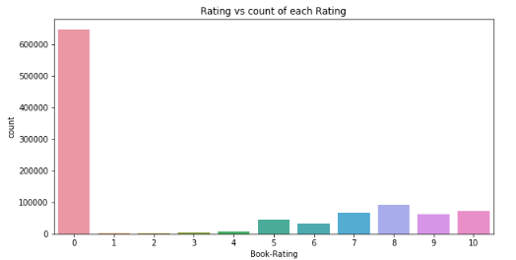
The count plot gives us idea about frequently rated value.
Here majority of the user has given a rating of 0

Slide 14
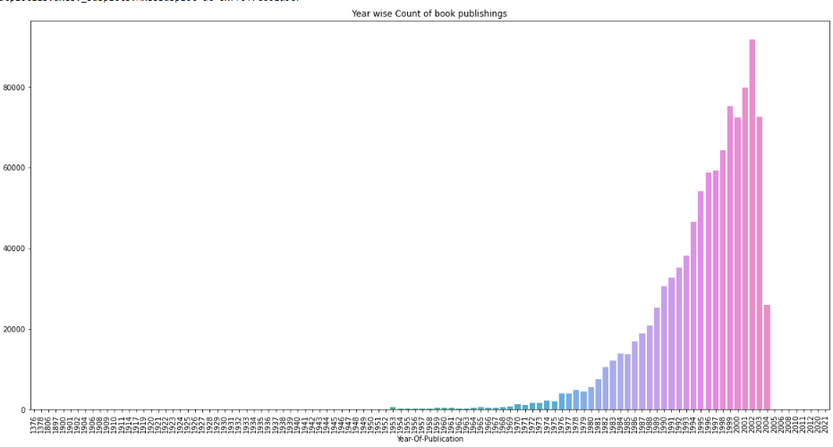
Bar chart show the count of books published in each year
From bar chart we can infer that Majority of books got published during the 1990-2003
The highest Number of publishing's we recorded during 2002

Slide 15
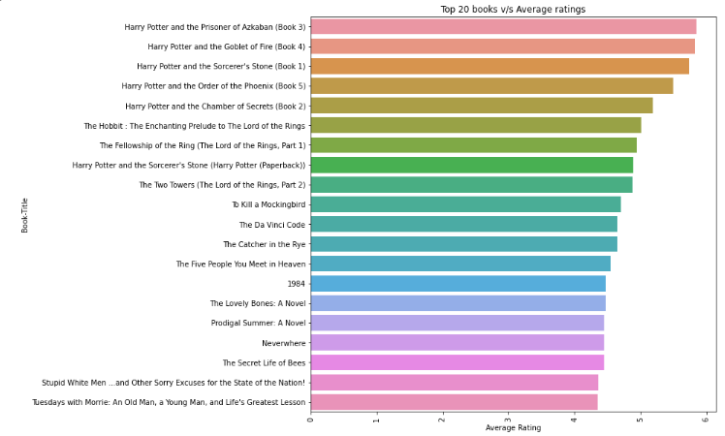
This plot gives the top 20 books based on Number of reviews and their Average Rating

Slide 16
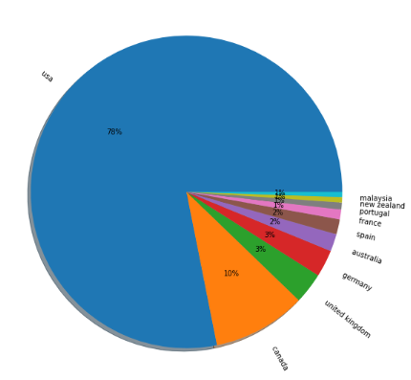
Top 10 Countries Based on active Readers
Pie chart show the percentage of active readers.
USA is having the highest active reader (7.4lakh readers).
Followed by Canada, with 91k readers

Slide 17
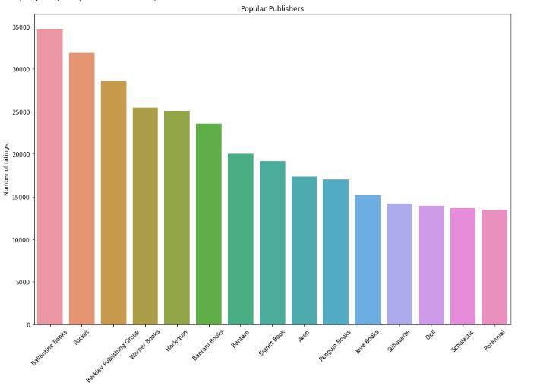
This plot Give’s the top 15 popular publisher’s based on the number of Ratings

Slide 18
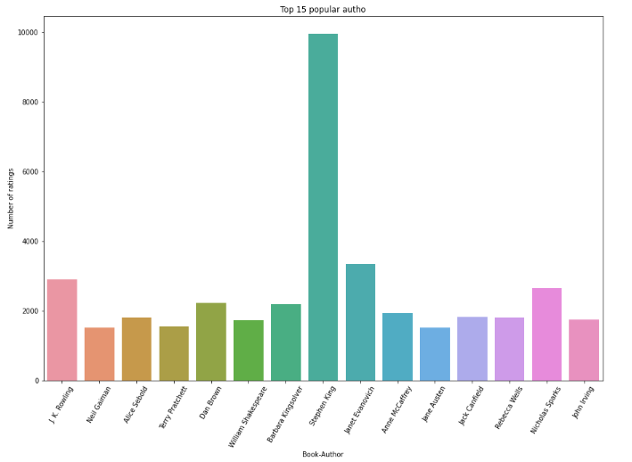
Plot gives the top 15 popular author’s based on the number of ratings and average rating of their book’s
The y-axis show the count of ratings

Slide 19
Model Building

Slide 20
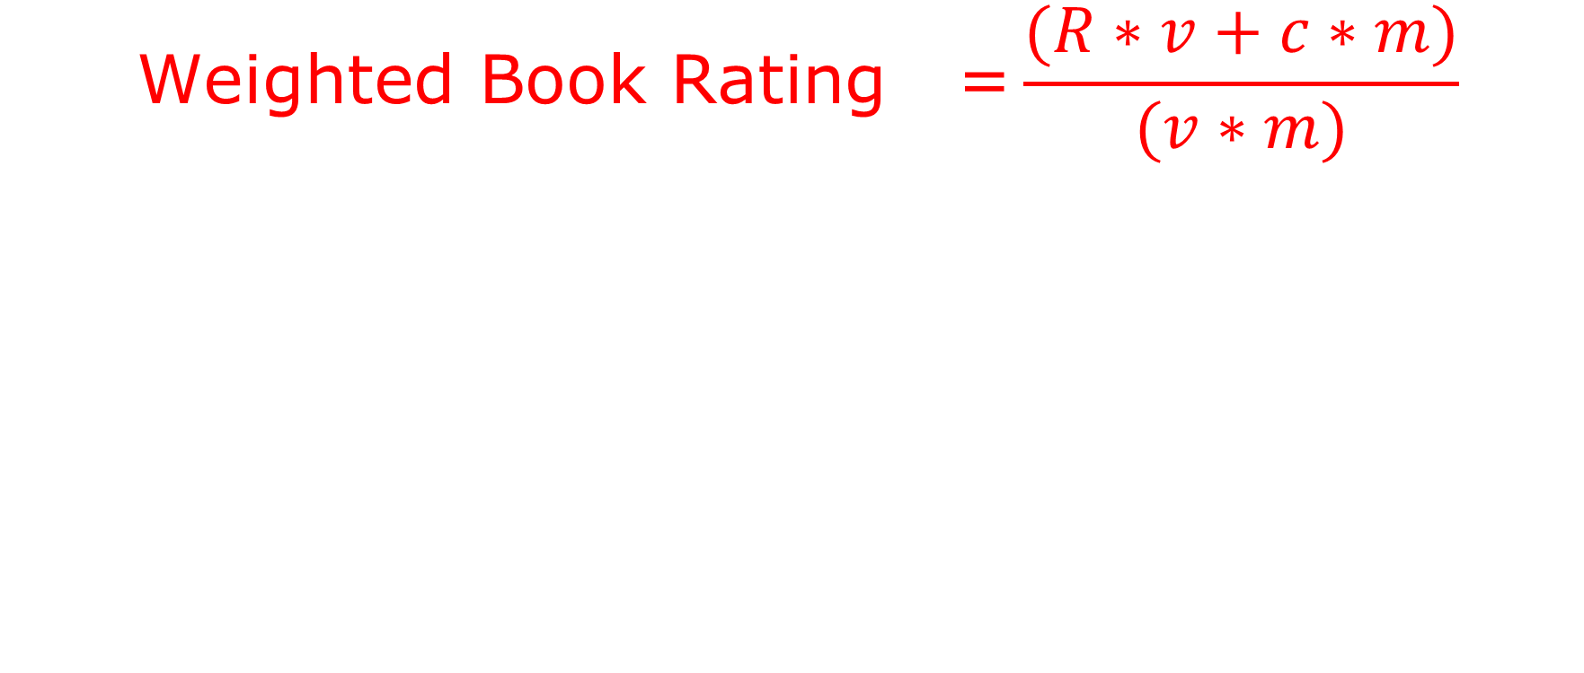
Weighted Average
$$\text{Weighted} \text{Book} \text{Rating}\text{ =}\frac{(R∗v+c∗m)}{(v∗m)}$$
R=Average rating of specific book.
V=Number of reviews/voting's of each book.
M=min number of reviews/voting’s(200).
C=mean of all average ratings(2.83).

Slide 21
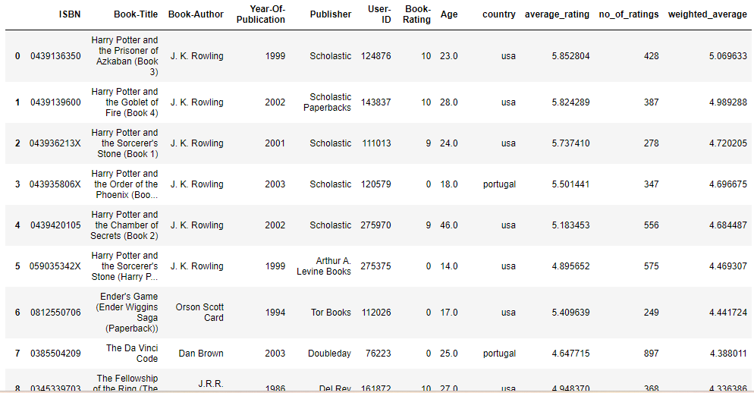
Top Books Based on Weighted Average

Slide 22
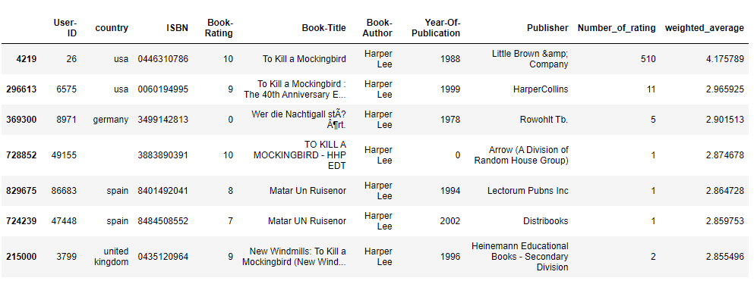
Author Based Recommendation
When the authors name is given, it will return a data frame which contains all the previous works of that author sorted based on the weighted average.

Slide 23
Collaborative Filtering (Item-Based)
1.Cosine-Similarity
For training the model we made use of data with:-
Books with min of 50 reviews/Voting’s were considered.
User’s who has reviewed min of 150 books were considered
Total of 839 user’s and 1102 books shortlisted.

Slide 24
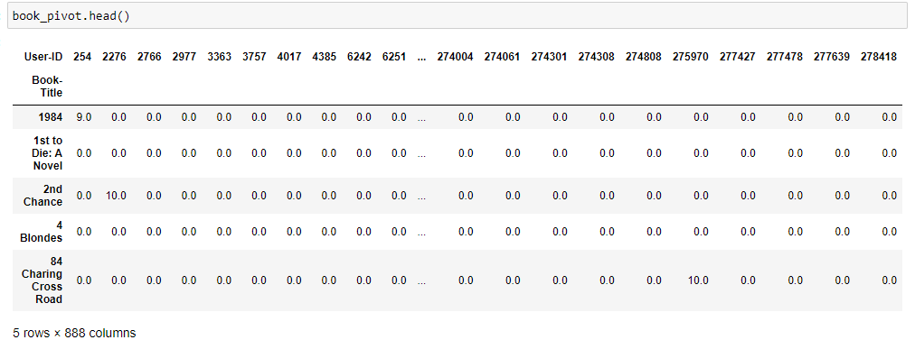
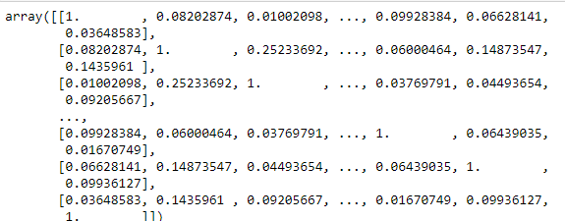
Created a pivot table
Calculated Cosine similarity between each pair of books
Shortlisted books with highest similarity

Slide 25
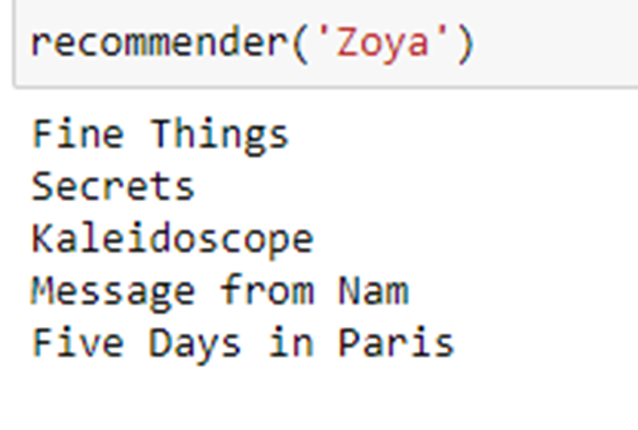
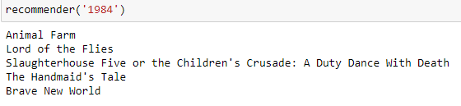
Output
It returns Book either from similar author or of similar genre

Slide 26
Collaborative Filtering (Item-Based)
2.Near Neighbour(Unsupervised clustering algorithm)
For training the model we made use of data with:-
Books with min of 50 reviews/Voting’s were considered.
User’s who has reviewed min of 200 books were considered(i.e: Only knowledgeable users will be considered )
Total of 742 user’s and 888 books shortlisted.

Slide 27
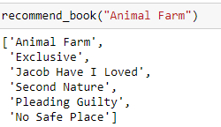
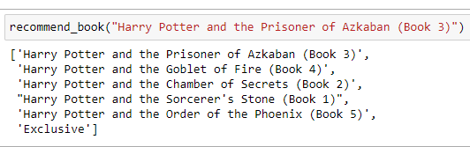
Output
It returns Book either from similar author or of similar genre
This model was giving more significant results

Slide 28
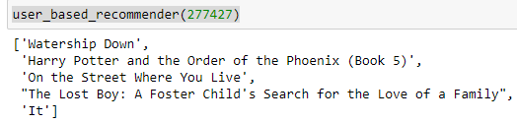
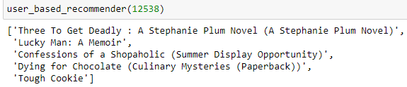
Collaborative Filtering (User-Based)
Recommendation for specific User
This algorithm helps to find similar user’s using pairwise distance method and shortlist them based on the highest similarity.
Recommend those book where the top similar user has rated more than 5.

Slide 29
Model Deployment
We have deployed both collaborative filtering method and popularity-based filtering method
Implemented Model’s using streamlit web application

Slide 30
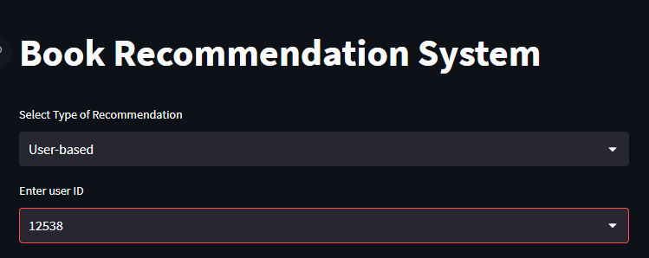
Here the user can select between the recommendation methods:-
User-Based Recommendation
Book based Recommendation
Popularity –Based Recommendation
Author –Based Recommendation

Slide 31

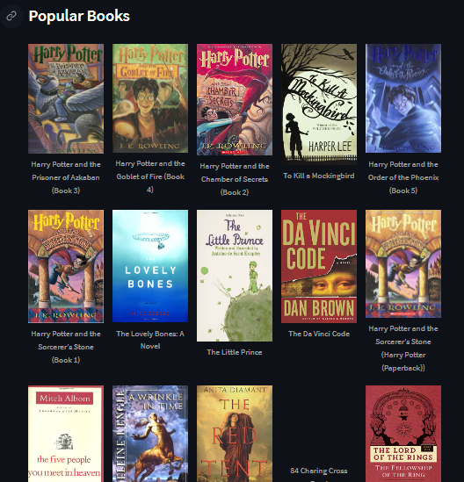
Popularity Based Recommendation
Displays the top 50 Popular books based Weighted rating.

Slide 32


Author Based Recommendation
Select the Author Name from the Drop box
Recommends The Authors famous works Ordered based on the weighted rating

Slide 33
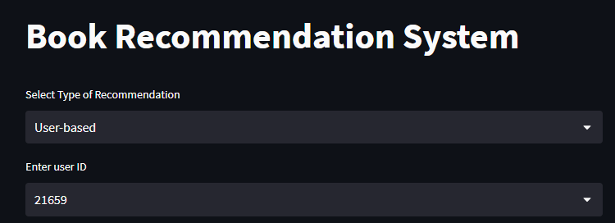

User-Based Recommendation
Here if the user select User-based recommendation Then he will be asked to enter the User-ID
Then Will be suggested with 5 book’s

Slide 34
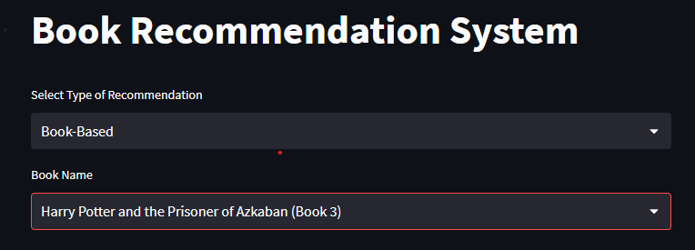

Book-Based Recommendation
Here if the user select Book-Based recommendation Then he will be asked to enter the Book name
Then Will be suggested with 5 book’s of Similar genre or from same author

Slide 35
Challenges Faced :-
Irrelevant recommendation for collaborative filtering.
Issues installing libraries in pycharm for deployment.
Understanding the evaluation metrics for recommendation system
How did you overcome?
Only considered with min popularity and reviews of knowledgeable user were considered.
Created virtual environment in VS Code for deployment.
Evaluated the model by finding the RMSE score of the model.

Slide 36
Thank you

